Slide 1
CSCI -112 Introduction to computer Systems
LAB
Instructor: Santanu Banerjee

Slide 2
64-bit Examples

Slide 3
5 bonus assignment points for completion and submission.

Slide 4
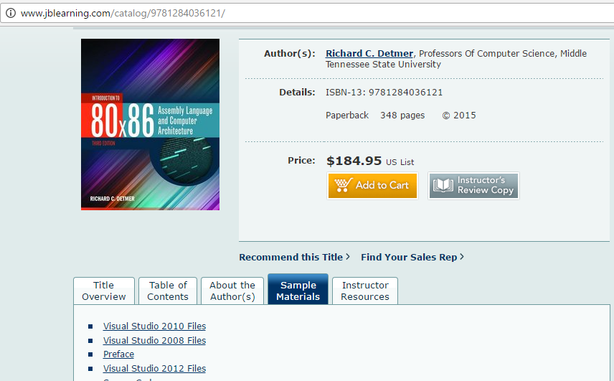
Framework Packages
Download from the publisher’s website.
These packages are used with Visual Studio for programs in this text

Slide 5
Framework Packages
Name | Use
console32 | Produces 32-bit programs, even in a 64-bit operating system No I/O provided Debugger used to see register and memory contents
console64 | Produces 64-bit programs—64-bit operating system required No I/O provided Debugger used to see register and memory contents
windows32 | Produces 32-bit programs, even in a 64-bit operating system Simple I/O using macros defined in the package Debugger available to see register and memory contents
windows64 | Produces 64-bit programs—64-bit operating system required Simple I/O using macros defined in the package Debugger available to see register and memory contents
Use the windows32 framework package for this exercise
These packages are used with Visual Studio for programs in this text

Slide 6
Exercise
Read Section 3.7 (Chapter 3) from the text book.
Read all the slides in this document.
Build and run the Console64 app just like the console32 app after applying the changes for 64 bit mode.

Slide 7
64-bit Differences
“Direct” memory addressing is actually RIP relative: the 32-bit offset stored in the instruction is added to RIP to get the operand address.
Extra code is required in windows64 programs
sub rsp,120 ; reserve stack space for MainProc
...
add rsp, 120 ; restore stack

Slide 8
console64 Example
Use the solution under console64 folder
Similar to console32, but fewer directives
Not required: .586, .MODEL FLAT, .STACK
Data segment uses QWORD instead of DWORD
Code segment uses RAX instead of EAX
Exits by storing 0 in RAX followed by ret

Slide 9
console64 Example
; Example assembly language program
.DATA
number QWORD -105
sum QWORD ?
.CODE
main PROC
mov rax, number
add rax, <your student ID>
mov sum, rax
mov rax, 0
ret
main ENDP
END

Slide 10
Debugger
64-bit addresses
64-bit registers

Slide 11
To earn points
Create and add code to the 64-bit project as instructed.
Debug through each line of code and examine the register and memory contents as code executes.
Submit a screenshot of the visual studio debug session showing
(i)your code (ii) memory (iii) registers
(Like the picture in the previous slide)
Play and experiment with the code.

